Slide 1
The basics of HTML and CSS

Slide 2
What is HTML
HTML is a computer language devised to allow website creation.
It is relatively easy to learn, with the basics being accessible to most people in one sitting;
It is quite powerful in what it allows you to create
It is constantly undergoing revision and evolution
The most recent incarnation is HTML5 ( » W3C)
Has many improvements but
Basic grammar has not changed → one of the most important standards for working with and on the Web.

Slide 3
General characteristics
HTML: HyperText Markup Language
Based on “tags” like latex or markdown
Relates to: tags-based text processing (TeX, IBM-script, Wordstar).
Combines power & simplicity
Hypertext and Hypermedia
HTML documentos are text (ASCII) files.
HTML is (intended to be) “portable”.

Slide 4
HTML editors
General purpose editors
Emacs, Textpad, Notepad++
Browser-related editors
Kompozer,
Specific editors
HoTMetaL, Quanta, Front Page
Word processors ☹

Slide 5
Reference guides
W3school.com
HTML5 Introduction (MOOC): https://www.edx.org/course/html5-introduction-w3cx-html5-0x-0
Google

Slide 6
HTML – CSS – Javascript
Web Page
Estructura
Structure
Paragraphs
Headings
Lists
Tables
Layers (divs)
Etc.
Párrafos
Encabezados
Listas
Tablas
Capas
Etc.
HTML
Content
Contenido
Text
Images
Links
Appearence
Colors
Typography
Alignment
Background
Sizes
Etc.
CSS
Behaviour
Effects
Validation
Automation
Javascript

Slide 7
HTML files
An HTML file is basically plain text that can be opened and edited with any text editor.
HTML’s power lies in its marked up structure.
HTML markup allows defining
the parts of a document that need to be displayed as headlines,
the parts that contain links,
the parts that should be organized as tables,
Etc.

Slide 8
HTML structure
HTML documents are made of HTML “elements”
Elements: Text (content) enclosed between two «tags»
Tags: Pairs of words enclosing content. Words are identical. closing tag starts by «/»

Slide 9
Tags, Elements and Attributes
Element
Opening tag
Content
Closing tag
<p class=“text”> HTML building blocks: elements </p>
Name
Value
Attribute

Slide 10
Minimal Document Structure
Some labels are compulsory: Any HTML document must have them
<HTML></HTML>
<HEAD></HEAD>
<BODY></BODY>

Slide 11
Example 1. Simplest HTML
<!DOCTYPE html>
<html>
<head>
<title>First HTML</title>
</head>
<body>
I am your first HTML-file!
</body>
</html>

Slide 12
Example 1-HTML5 improvements
<!DOCTYPE html>
<html lang="en">
<head>
<meta charset="utf-8">
<title>You Can Edit This</title>
</head>
<body>
<h1>I Mean, You Can Really Edit This</h1>
<p contenteditable=true>
Now is the time for all good cats to come
But in our brave new world of HTML5, all we need is:
to the aid of their catnip.
</p>
</body>
</html>

Slide 13
Basic text formatting
Headings
<H1></H1>...........<H6></H6>
Paragraph breaks
<P></P>
Centering
<CENTER></CENTER>
Bold and Italic
<B></B> <I></I>

Slide 14
Tag attributes
Paragraph alignment
Left: ALIGN=left (default)
Right: ALIGN=right
Centered: ALIGN=center
Use
<p ALIGN=option>

Slide 15
Lists
Unordered Lists
<UL>
<LI>
</UL>
Ordered Lists
<OL>
<LI>
</OL>

Slide 16
Example 2: lists
<!DOCTYPE html>
<html lang="en">
<head> <title>Ordered and unordered lists </title></head>
<body>
<h1> Ordered list</h1>
<OL> <LI> First
<LI>Second
<LI>Third
</OL>
<h1> Unordered list</h1>
<UL> <LI>Natural Sciences
<UL> <LI>Biology
<LI>Zoology
</UL>
<LI>Social Sciences
<UL> <LI>Geography
<LI>History
</UL>
</UL>
</body>
</html>

Slide 17
HTML grouping tags: DIV & SPAN
Used to define sections in documents
<div> Defines a block-level section
Used as a container for other HTML elements
<span> Defines an inline section
Used as container for some text
No required attributes
often use style, class or id
Often used in conjunction with CSS

Slide 18
DIV and SPAN example
<!DOCTYPE html >
<html lang="en">
<head> <title>Span and Div</title></head>
<body>
<h1> The &lt;DIV&gt; tag </h1>
The &lt;DIV&gt; tag defines a division or a section in an HTML document.<br>
In the example below &lt;DIV&gt; is used to create a section in a document
that will have a light blue background color:
<div style="background-color:lightblue">
<h3>This is a heading</h3>
<p>This is a paragraph.</p>
</div>
<h1> The &lt;SPAN&gt; tag </h1>
In the example below &lt;SPAN&gt; is used to change the color of a single word in a paragraph:
<p>My mother has <span style="color:blue">blue</span> eyes.</p>
</body> </html>

Slide 19
Other tags
Horizontal line <HR>
<HR> attributes
<HR NOSHADE SIZE=value WIDTH=“percentge” ALIGN=value>
<BLINK> tag (Example 4)
<BLINK> ¡Hello John! </BLINK>
<META> tag
<META HTTP-EQUIV= “refresh” CONTENT= “5; url=http://www.uam.es” >

Slide 20
Tables
Tables are used for
Storing tabular information
Create/organize the page layout.
Tags used for managing tables are:
<TABLE> </TABLE> Begin and End of the table <TR> </TR> Define table rows <TD> </TD> Define table columns
Table structure is very flexible.
Table tags are hierarechichal: a table has one or more rows each of which is divided in one or more columns

Slide 21
Example HTML Table
<!DOCTYPE html>
<html>
<head>
<title>HTML Tables</title>
</head>
<body>
<h1>An HTML Table</h1>
<table>
<tr> <th>Rank</th> <th>Nominal GDP</th> <th>Name</th> </tr>
<tr> <th></th> <th>(per capita, USD)</th> <th></th> </tr>
<tr> <td>1</td> <td>170,373</td> <td>Lichtenstein</td> </tr>
<tr> <td>2</td> <td>167,021</td> <td>Monaco</td> </tr>
<tr> <td>3</td> <td>115,377</td> <td>Luxembourg</td> </tr>
<tr> <td>4</td> <td>98,565</td> <td>Norway</td> </tr>
<tr> <td>5</td> <td>92,682</td> <td>Qatar</td> </tr>
</table>
</body>
</html>

Slide 22
Images
Inserted using a graphical file (GIF, JPEG, PNG, BMP, ...)
Sintax:
<IMG SRC= “image.gif” >
Attributes
<IMG SRC= “image.gif” HEIGHT= value WIDTH= value>
Alignment
<IMG SRC= “image.gif” ALIGN= top>

Slide 23
Backgrounds
Maybe: Textures, Images or Colors
Sintax:
<BODY BACKGROUND= “fondo.gif” >
<BODY BGCOLOR= “color” >

Slide 24
Hyperlinks
Hyperlinks allow linking any two pages independently of their physical location
Examples:
<A HREF= “http://www.elpais.es” > Diario El País </A>
<A HREF= “Example1.html” > Página1 </A>
<A HREF= “http://www.uam.es” ><IMG SRC= “imagen.gif” ></A>

Slide 25
Hyperlinks to different sections of HTML pages
Link from a page (e.g: an author index authors.html) to a specific section in another documento (autores.html). (hiperenlace 2)
First create the reference in th first document:
<A HREF= “authors.html#A1” > Autor1 </A>
Next create the anchor in the second document:
<A NAME= “A1” > Autor1 </A>

Slide 26
Hyperlinks between sections of same HTML page
Links from one page (authors.html) to a section in the same document
First create the reference:
<A HREF= “#A1” > Autor1 </A>
Next create anchor in the same document:
<A NAME= “A1” > Autor1 </A>

Slide 27
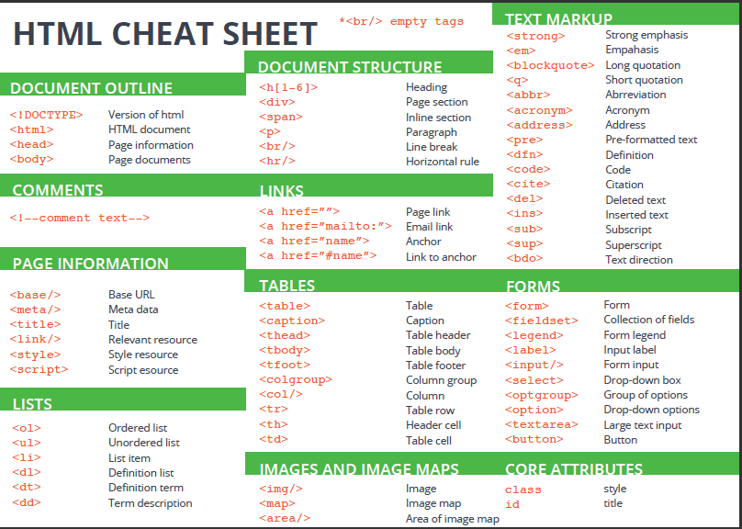

Slide 28
Synthesis exercise
Select a topic you feel comfortable with.
Write or get a text that is organized in, at least two or three sections.
Allow the code to have all the elements we have learnt about: text, tables, images, hyperlinks...
Organize it in sections
Start with a table of contents
Formatted by an ordered list
Each element must link to each section's title.
Continue with sections
Títle: Headings of same type
End each section with a link to the table of contents followed by a horizontal bar.

Slide 29
Cascading Style Sheets (CSS)

Slide 30
What are CSS
CSS complements HTML by providing a look and feel to web pages.
“raw” HTML pages can look fairly plain, with a default font and font size.
Using CSS, you can spice up that look,
adding color and background images,
changing fonts and font sizes,
drawing borders around areas, and
even changing the layout of the page itself.

Slide 31
Why use CSS
Before CSS, an HTML developer changed fonts and colors by changing attributes on each element.
If the developer wanted all the headings to look a certain way, she had to change each of those headings.
Imagine doing this on a page with ten headings, and then imagine doing it on 50 pages.
CSS alleviates this burden of individually updating elements and makes it so that you can apply one single style across one or more elements.
You can apply multiple styles to the same element, and you can target a certain style down to the individual element.
For example, if you want all headings to be bold font but a certain heading should have italic, you can do that with CSS.

Slide 32
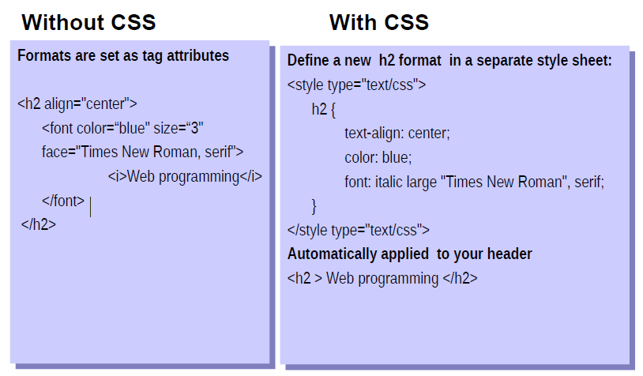
Separating content from presentation

Slide 33
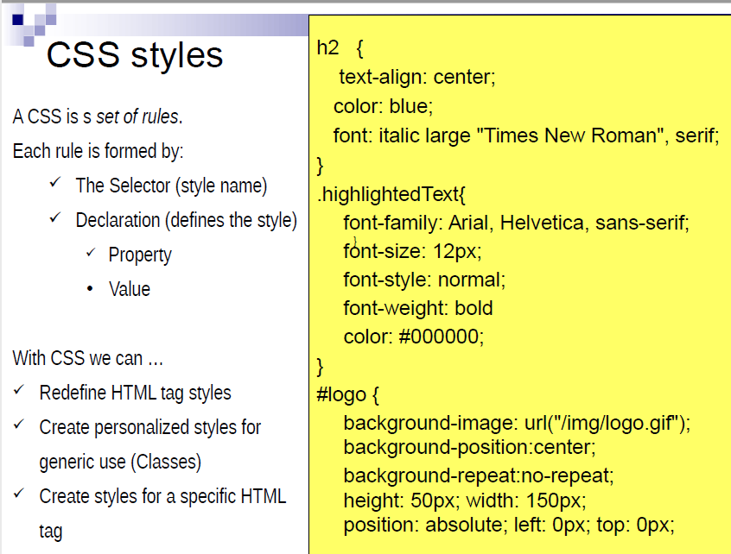

Slide 34
CSS Syntax
CSS syntax is made up of 5 parts
Selector
Property/Value
Declaration
Declaration block
Curly braces

Slide 35
Selectors
Selectors are used to declare which part of the markup a style applies to, a kind of match expression.
3 types of selectors
1) Tag (or Type) selectors (body, p, div, a): Redefine existing tags
2) Class selectors (.content, .menu): Define a new type of tag
3) ID selectors (#wrapper, #sidebar): Create and name a new tag
The selector is normally the HTML element you want to style
Selectors should never start with a number, nor should they have spaces in them

Slide 36
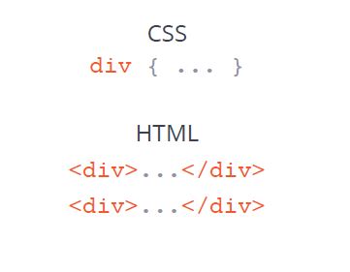
Tag selectors
Target elements by their element type
Example
span{
background-color: skyblue;
}
<span>Here’s a span with some text </span>
<p>Here’s a p with some text </p>

Slide 37
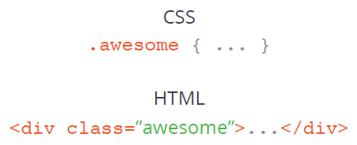
Class selectors
Allow selecting an element based on
the element’s class attribute value.
Example
.center {text-align:center;}
p.center {text-align:left;}
<h1 class="center">Center-aligned heading</h1>
<p class="center">Center-aligned paragraph.</p>
<p class="left">Center-aligned paragraph.</p>

Slide 38
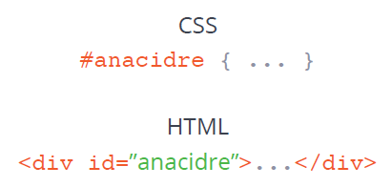
ID selectors
More precise than class selectors, as they target only one unique element at a time
Example
#wrapper
{text-align:center;
border:1px solid red;
Width: 200px;
Height: 100px
}
<div id="wrapper">… </div>

Slide 39
Class vs ID selectors
The difference between an ID and a class is that
an ID can be used to identify one element,
whereas a class can be used to identify more than one.
#top { background-color: #ccc;
padding: 20px }
.intro { color: red;
font-weight: bold; }
<div id="top">
<h1>Chocolate curry</h1>
<p class="intro">
This is my recipe for
making curry purely
with chocolate</p>
<p class="intro">Mmm mm mmmmm</p>
</div>

Slide 40
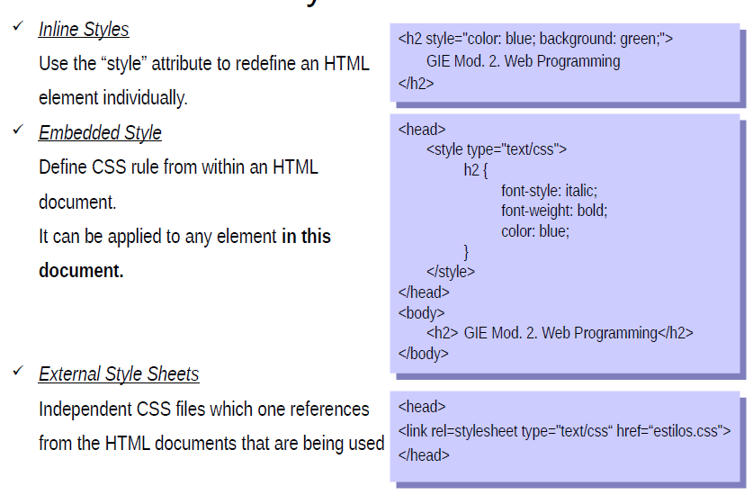
How CSS styles are used

Slide 41
An exemple CSS file
/* Applies to the entire body of the HTML document (except where overridden by more specific selectors). */
body {
margin: 25px;
background-color: rgb(240,240,240);
font-family: arial, sans-serif;
font-size: 14px;
}
/* Applies to all <h1>...</h1> elements. */
h1 {
font-size: 35px;
font-weight: normal;
margin-top: 5px;
}
/* Applies to all elements with <... class="someclass"> specified. */
.someclass { color: red; }
/* Applies to the element with <... id="someid"> specified. */
#someid { color: green; }

Slide 42
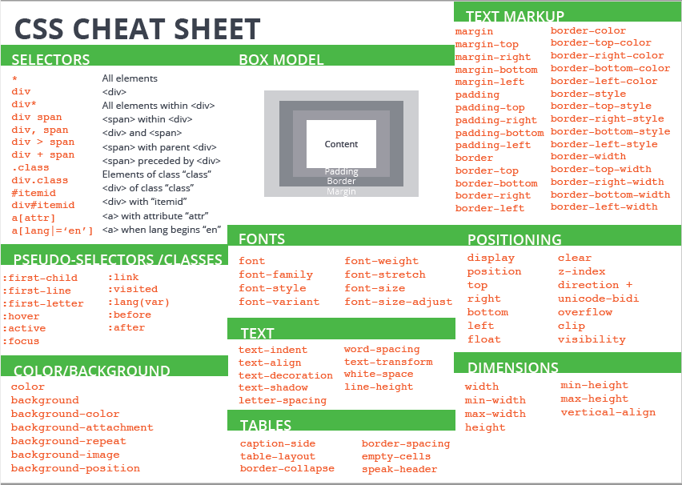

Slide 43
Exercise
Assuming you have created a basic web site with, at least two pages, create a CSS file that modifies, at least:
Color, font and text properties
Affecting to general elements such as the body and particular ones such as headings
Link that CSS to all pages in the site
Create a new CSS file by making some changes to the first one.
Link each file to a different page
Link both CSS to one of the pages. See the effects of cascading.

